Slide 1

Unit-3: 8085 Microprocessor
Microprocessor and Interfacing
(MPI)
GTU # 3160712
Prof. Swati R Sharma
Computer Engineering Department
swati.sharma@darshan.ac.in
(O) 9727747317

Slide 2
Subject Overview
Sr. No. | Unit | % Weightage
1 | Introduction to Microprocessor | 8%
2 | Microprocessor Architecture and Operations | 7%
3 | 8085 Microprocessor | 12%
4 | Assembly Language Programming Basics | 13%
5 | 8085 Assembly Language Programs | 12%
6 | Stack & Subroutines | 13%
7 | I/O Interfacing | 20%
8 | Advanced Microprocessors | 15%

Slide 3

Looping
Topics to be covered
Introduction to 8085
8085 Programming Model
Bus Organization of 8085
8085 pin diagram
8085 Architecture/Block Diagram
T-States, Machine and Instruction Cycle
Demultiplexing Address and Data Bus AD0-AD7
Timing Diagram
Memory Interfacing
Generating Control Signals

Slide 4
Introduction to 8085

Slide 5
Introduction to 8085
8085 is pronounced as "eighty-eighty-five" microprocessor.
It is an 8-bit microprocessor designed by Intel in 1977 using NMOS technology.
Notes:
N-type metal-oxide-semiconductor logic

Slide 6
Introduction to 8085
8 bit General purpose microprocessor (i.e. 8 bit data bus).
It is a single chip N MOS device with 40 pins.
It has multiplexed address and data bus.(AD₀ - AD₇).
It works on 5-Volt DC power supply.
The maximum clock frequency is 3MHz while minimum frequency is 500kHz.
It provides 16 address lines, therefore capable of addressing 2¹⁶= 64K of memory.
It supports external interrupt request.
It has two 16 bit registers named program counters (PC) and stack pointer (SP).
Notes:
A NPN transistor has electrons as majority charge carriers whereas the PNP transistor has holes as majority charge carrier. The mobility of electrons is better than mobility of holes. So a NPN transistor is faster in operation than a PNP transistor.

Slide 7
Introduction to 8085
It generates 8 bit I/O address so it can access 2⁸ = 256 input ports.
It provides 5 hardware interrupts:
TRAP
RST 5.5
RST 6.5
RST 7.5
INTR
It provides accumulator, 5 flag register, 6 general purpose registers and 2 special purpose registers (SP,PC).

Slide 8
8085 Programming Model

Slide 9
8085 Programming Model
Accumulator A (8)
Flag Register
B (8)
C (8)
D (8)
E (8)
General Purpose Registers
H (8)
L (8)
Stack Pointer (SP) (16)
Program Counter (PC) (16)
Data Bus
Address Bus
8
16
Bidirectional
Unidirectional

Slide 10
General Purpose Registers
6 general purpose registers to store 8-bit data B, C, D, E, H & L.
Can be combined as fixed register pairs – BC, DE, HL to perform 16 bit operations.
Used to store or copy data using data copy instructions.
B (8)
C (8)
D (8)
E (8)
H (8)
L (8)

Slide 11
8085 Programming Model
Accumulator A (8)
Flag Register
B (8)
C (8)
D (8)
E (8)
H (8)
L (8)
Stack Pointer (SP) (16)
Program Counter (PC) (16)
Data Bus
Address Bus
8
16
Bidirectional
Unidirectional

Slide 12
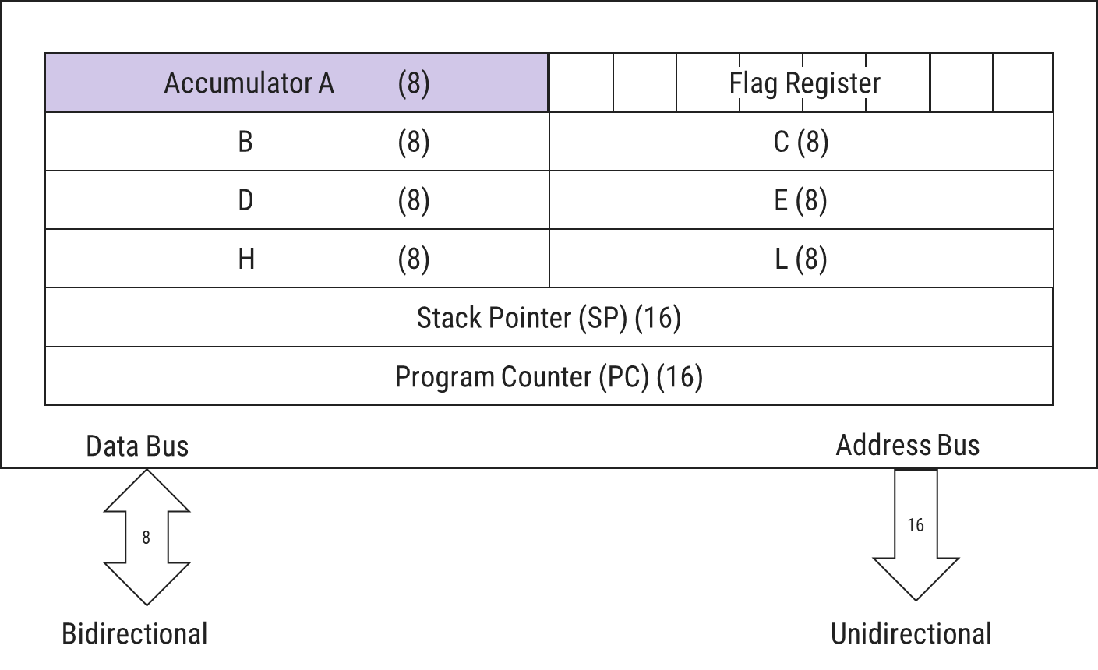
Accumulator
8 - bit register, identified as A
Part of ALU
Used to store 8-bit data to perform arithmetic & logical operations.
Result of operation is stored in Accumulator.

Slide 13
8085 Programming Model
Accumulator A (8)
Flag Register
B (8)
C (8)
D (8)
E (8)
H (8)
L (8)
Stack Pointer (SP) (16)
Program Counter (PC) (16)
Data Bus
Address Bus
8
16
Bidirectional
Unidirectional

Slide 14
Flag Register
D₇ | D₆ | D₅ | D₄ | D₃ | D₂ | D₁ | D₀
S | Z | Χ | AC | Χ | P | Χ | CY
Χ:Undefined
P -Parity Flag
Set (1) if result has even no. of 1’s & Reset(0) if result has odd no. of 1’s
S -Sign Flag
Set (1) if 7th bit of result is 1;
otherwise reset (0)
AC -Auxiliary Carry Flag
Set (1) when carry bit is generated by 3rd bit & passed to bit 4th bit.
CY -Carry Flag
Set (1) if arithmetic operation results in carry;
otherwise reset(0)
1 0 0 1 0 0 1 1
P = 1
1 0 1 0 1 0 1 0
S = 1
Z -Zero Flag
Set (1) when result is zero; otherwise reset(0)
1 1 1
1 0 1 0 1 0 1 0
+ 0 1 1 0 1 0 0 1
1 0 0 0 1 0 0 1 1
CY = 1
1 0 1 0
- 1 0 1 0
0 0 0 0
Z = 1
1 1 1
0 0 1 0 1 0 1 0
+ 0 1 1 0 1 0 0 1
1 0 0 1 0 0 1 1
AC = 1

Slide 15
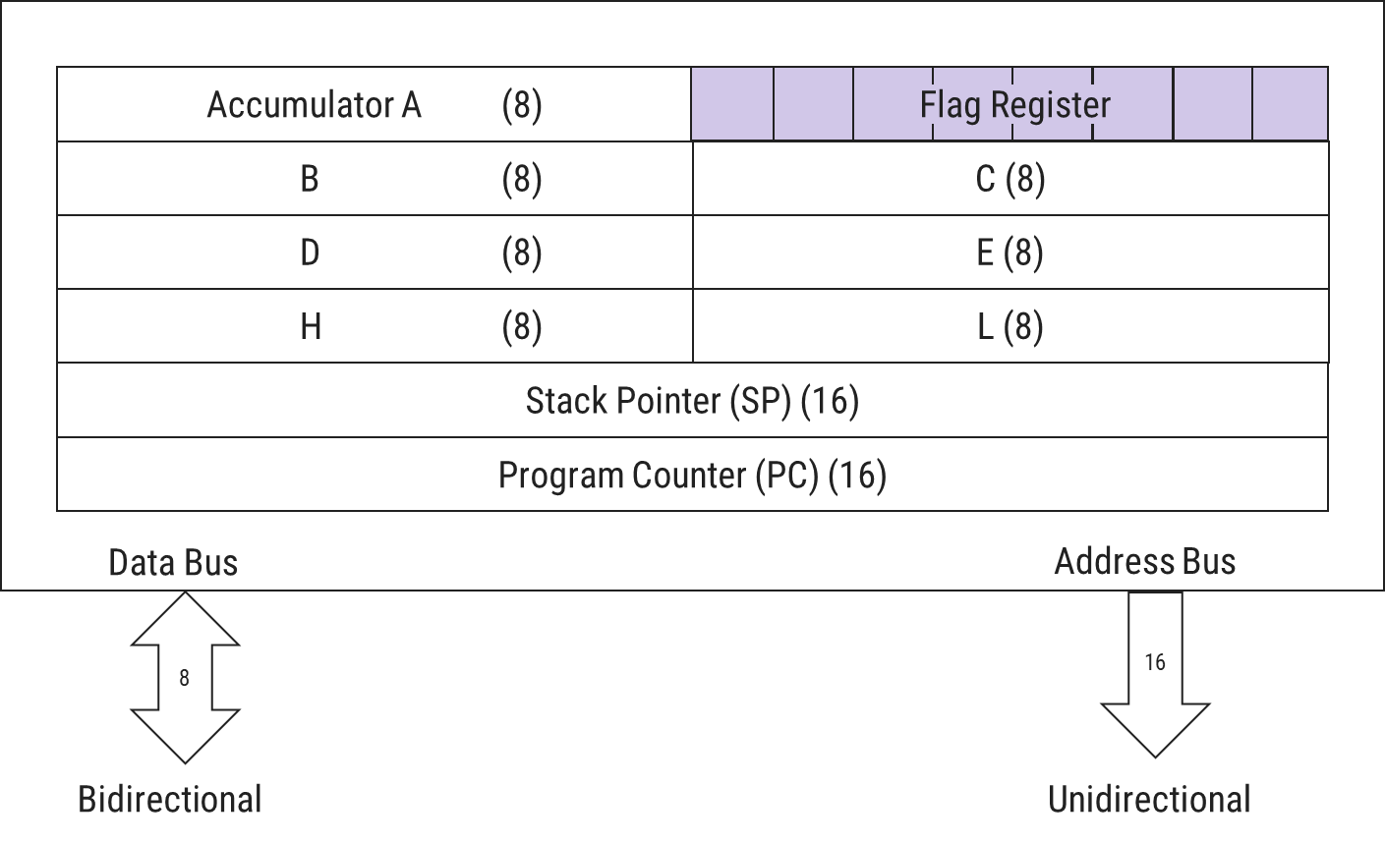
Flag Register
ALU has 5 Flag Register that set/reset after an operation according to data conditions of the result in accumulator & other registers.
Helpful in decision making process of microprocessor.
Conditions are tested through software instructions.
For e.g.
JC (Jump On Carry) is implemented to change the sequence of program when CY(Carry Flag) is set(1).

Slide 16
8085 Programming Model
Accumulator A (8)
Flag Register
B (8)
C (8)
D (8)
E (8)
H (8)
L (8)
Stack Pointer (SP) (16)
Program Counter (PC) (16)
Data Bus
Address Bus
8
16
Bidirectional
Unidirectional

Slide 17
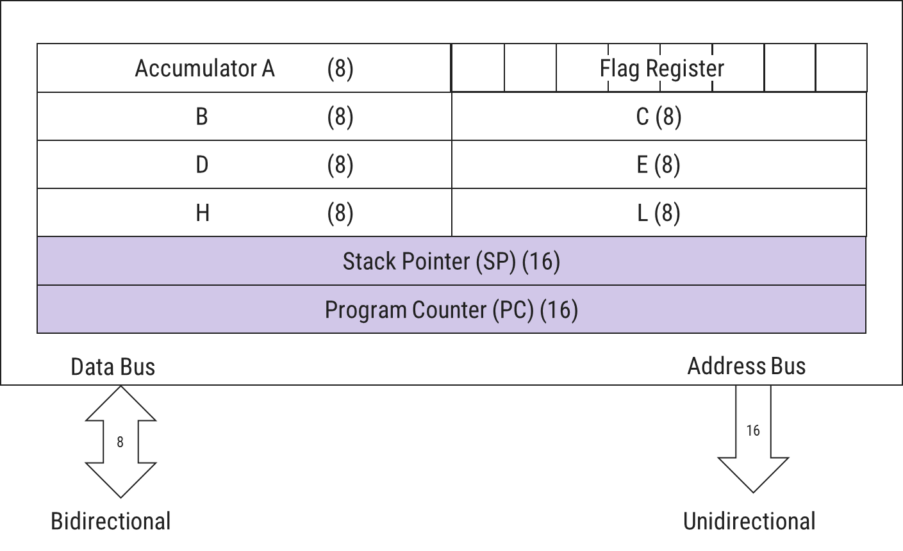
Stack Pointer & Program Counter
Stack Pointer(SP)
Used as memory pointer.
Points to the memory location in R/W memory, called Stack.
Beginning of stack is defined by loading a 16-bit address in the stack pointer.
Program Counter(PC)
Microprocessor uses PC register to sequence the execution of instructions.
Its function is to point to memory address from which next byte is to be fetched.
When a byte is being fetched, PC is incremented by 1 to point next memory location.
GTU Que: Explain 8085 Programming Model and flag register.[7m] (W’18,W’19)

Slide 18
Bus Organization of 8085

Slide 19
System bus
CPU
Memory
Input/Output
System Bus
Control Bus
Address Bus
Data Bus

Slide 20
Bus Organization of 8085
8085 MPU
Address Bus
A₁₅
A₀
Memory
Input
Output
D₇
Data Bus
D₀
Control Bus

Slide 21
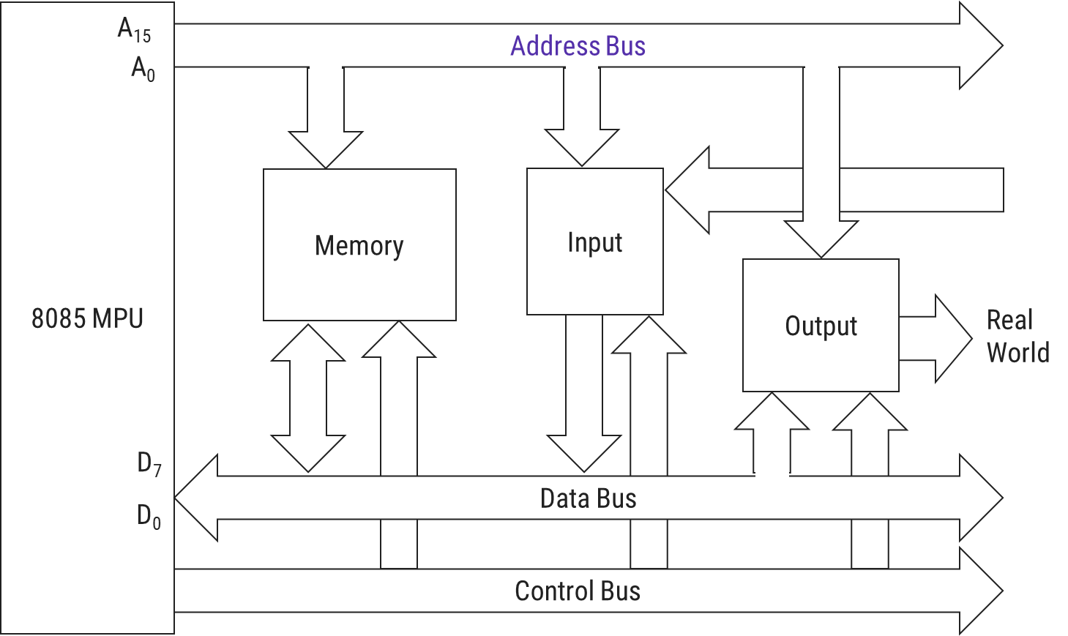
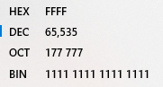
Address bus
Group of 16 unidirectional lines generally identified as A₀ to A₁₅.
i.e. bits flow from microprocessor to peripheral devices.
16 address lines are capable of addressing 65536 memory locations. So, 8085 has 64K memory locations.

Slide 22
Bus Organization of 8085
8085 MPU
Address Bus
A₁₅
A₀
Memory
Input
Output
Real World
D₇
Data Bus
D₀
Control Bus

Slide 23
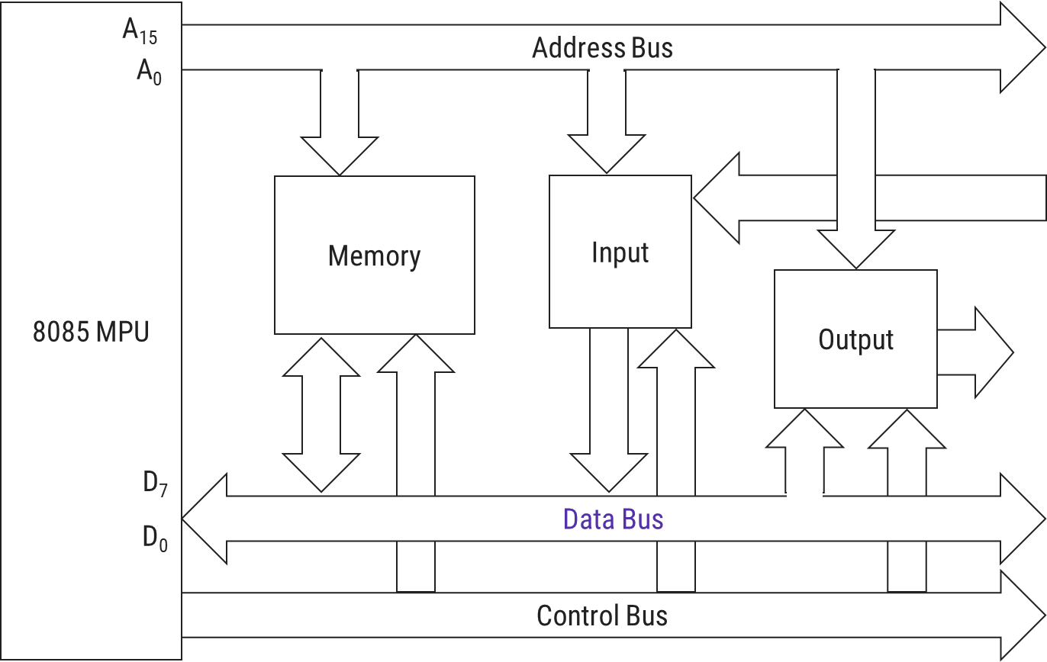
Data bus
Group of 8 lines identified as D₀ to D₇.
They are bidirectional i.e. data flow in both directions between microprocessor, memory & peripheral.
8 data lines enable microprocessor to manipulate data ranging from 00 H to FF H (2⁸=256 numbers).
Largest number appear on data bus is 1111 1111 => (255)₁₀.
As Data bus is of 8-bit, 8085 is known as 8-bit Microprocessor.
Notes:
8086- 16-nit
386,486-32 bit

Slide 24
Bus Organization of 8085
8085 MPU
Address Bus
A₁₅
A₀
Memory
Input
Output
D₇
Data Bus
D₀
Control Bus

Slide 25
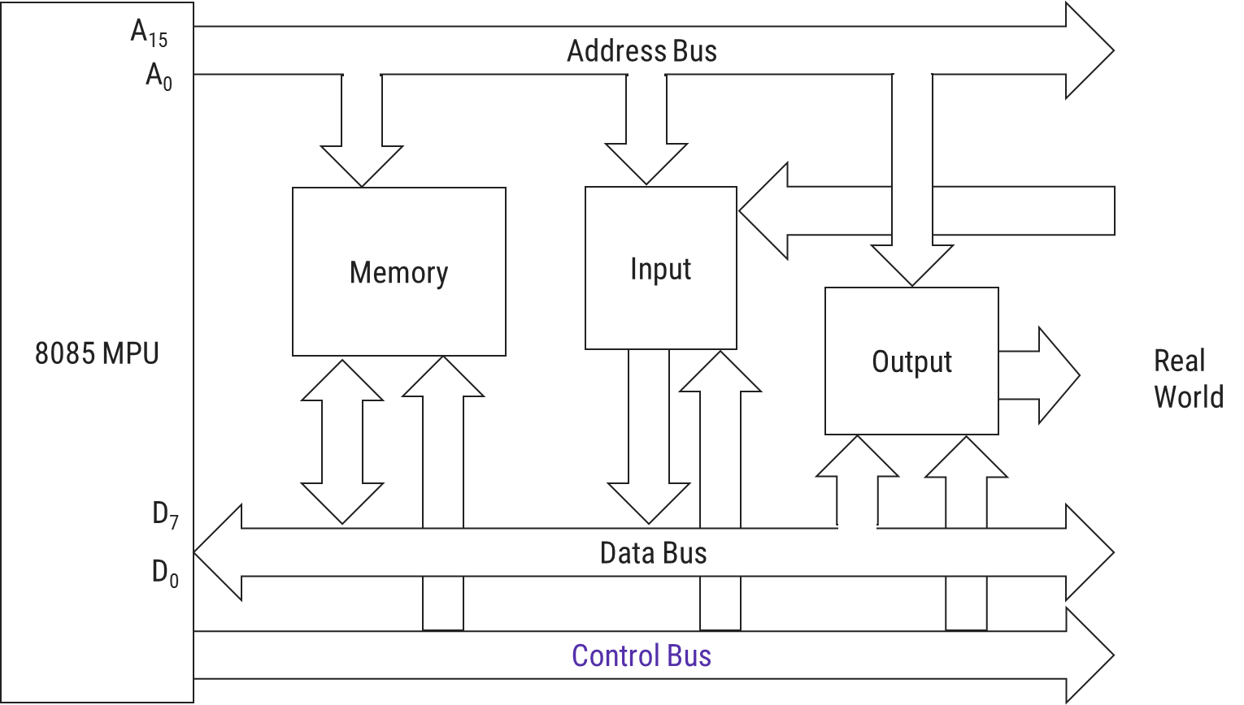
Control bus
It comprises of various single lines that carry synchronization, timing & control signals.
These signals are used to identify a device type with which MPU intends to communicate.
Some control signals are Read, Write and Opcode fetch etc.

Slide 26
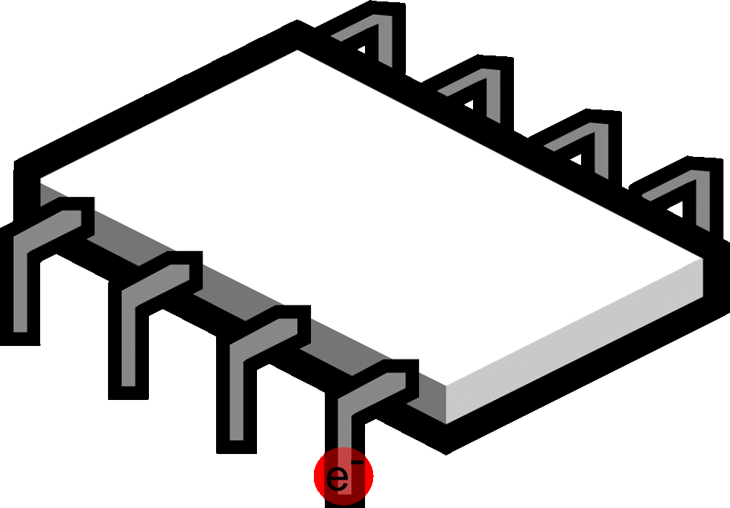
8085 pin diagram
8085 pin diagram

Slide 27
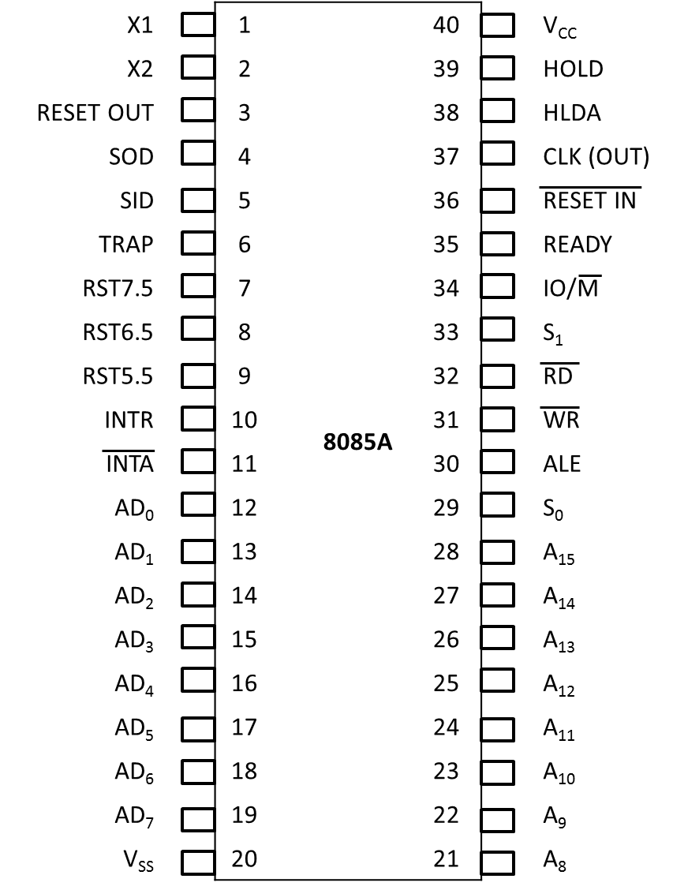
8-bit general purpose microprocessor.
Capable of addressing 64K of memory.
It has 40 pins.
Requires +5V single power supply.
8085 pin diagram

Slide 28
8085 pin diagram
Signals are classified into 6 groups:
Address bus
Multiplexed address/data bus
Control & status signals
Power supply & frequency signals
Externally initiated signals
Serial I/O ports

Slide 29
8085 pin diagram: Address Bus
16 signal lines are used as address bus.
However these lines are split into two segments: A₁₅ - A₈ and AD₇ - AD₀
A₁₅ - A₈ are unidirectional and used to carry high-order address of 16-bit address.
AD₇ - AD₀ are used for dual purpose.

Slide 30
8085 pin diagram: Multiplexed Address/Data Bus
Signal lines AD₇-AD₀ are bidirectional and serve dual purpose.
They are used as low-order address bus as well as data bus.
The low-order address bus can be separate from these signals by using a latch (ALE).

Slide 31
8085 pin diagram: Control & Status Signals
To identify nature of operation
Two Control Signals
RD(Read)
WR(Write)
Three Status Signals
S₁
S₀
IO/M
To indicate beginning of operation
ALE(Address Latch Enable)
ALE ← 1, then Address bus
ALE ← 0, then Data bus

Slide 32
8085 pin diagram: Control & Status Signals
ALE: Pin 30
This is positive going pulse generated every time the 8085 begins an operation (machine cycle).
It indicates that the bits on AD₇-AD₀ are address bits.
This signal is used primarily to latch the low-address from multiplexed bus & generate a separate set of address lines A₇-A₀.

Slide 33
8085 pin diagram: Control & Status Signals
RD(Read): Pin 32
This is a read control signal (active low)
This signal indicates that the selected I/O or Memory device is to be read & data is available on data bus.

Slide 34
8085 pin diagram: Control & Status Signals
WR (Write): Pin 31
This is a write control signal (active low)
This signal indicates that the selected I/O or Memory device is to be write & data is available on data bus.

Slide 35
8085 pin diagram: Control & Status Signals
IO/M: Pin 34
This is a status signal used to differentiate I/O and memory operation.
When signal is
high → I/O operation
low → Memory operation
This signal is combined with RD and WR to generate I/O & memory control signals.

Slide 36
8085 pin diagram: Control & Status Signals
S₁ (Pin 33) & S₀ (Pin 29)
These status signals can identify various operations.
S₁ | S₀ | Mode
0 | 0 | HLT
0 | 1 | WRITE
1 | 0 | READ
1 | 1 | OPCODE FETCH

Slide 37
8085 pin diagram
I0/M | RD | WR | Operation
0 | 0 | 0 | HLT
MEMR
0 | 0 | 1
0 | 1 | 0
MEMW
0 | 1 | 1 | Opcode Fetch
1 | 0 | 0 | HLT
1 | 0 | 1
IOR
1 | 1 | 0
IOW
1 | 1 | 1 | NOP

Slide 38
8085 Pin Diagram: Power Supply & Frequency Signal
V_{cc} → Pin 40, +5V Supply.
V_{ss} → Pin 20, Ground Reference

Slide 39
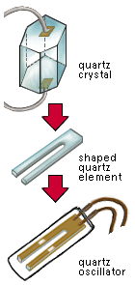
8085 Pin Diagram: Power Supply & Frequency Signal
X1, X2 → Pin 1 & 2, Crystal Oscillator is connected at these two pins.
The frequency is internally divided by two;
therefore, to operate a system at 3MHz, the crystal should have a frequency of 6MHz.

Slide 40

8085 Pin Diagram: Power Supply & Frequency Signal
CLK (OUT) → Clock output
Pin 37: This signal is used as system clock for other I/O devices for synchronization with Microprocessor.

Slide 41
8085 Pin Diagram: Externally Initiated Signals
INTR(Input) → Interrupt Request
It is used for general purpose interrupt.
INTA(Output) → Interrupt Acknowledge.

Slide 42
8085 Pin Diagram: Externally Initiated Signals
RST7.5, RST6.5, RST5.5 (Input) → Restart Interrupts.
These are vector interrupts that transfer the program control to specific memory locations.
RST7.5, RST6.5, RST5.5 have higher priorities than INTR interrupt.
Among these 3 interrupts, the priority order (higher to lower) is RST7.5, RST6.5, RST5.5 respectively.
Notes:
In a computer, a vectored interrupt is an I/O interrupt that tells the part of the computer that handles I/O interrupts at the hardware level that a request for attention from an I/O device has been received and also identifies the device that sent the request.

Slide 43
8085 Pin Diagram: Externally Initiated Signals
TRAP(Input) → This is a non maskable interrupt & has the highest priority.

Slide 44
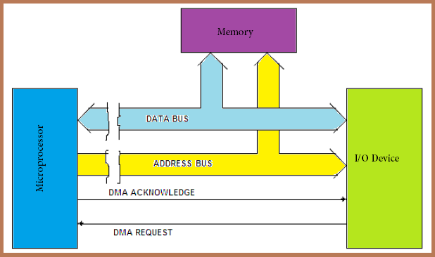
8085 Pin Diagram: Externally Initiated Signals
HOLD(Input) → This signal indicates that a peripheral such as DMA Controller is requesting the use of address & data buses.
HLDA(Output) → Hold Acknowledge. This signal acknowledges the HOLD request.
Notes:
Direct Memory Access Controller is an external device that controls the transfer of data between I/O device and memory without the involvement of the processor. It holds the ability to directly access the main memory for read or write operation.

Slide 45
8085 Pin Diagram: Externally Initiated Signals
READY(Input) → This signal is used to delay the microprocessor read or write cycles until low-responding peripheral is ready to send or accept data.
When the signal goes low, the microprocessor waits for an integral no. of clock cycles until READY signal goes high.

Slide 46
8085 Pin Diagram: Externally Initiated Signals
RESET IN (Input) → When the signal on this pin goes low, the Program Counter is set to zero, the buses are tri-stated & microprocessor is reset.
RESET OUT (Output) → This signal indicates that microprocessor is being reset. The signal is also used to reset other devices.

Slide 47
8085 Pin Diagram: Serial I/O Ports
Two pins for serial transmission
SID (Serial Input Data)
SOD (Serial Output Data)
In serial transmission, data bits are sent over a single line, one bit at a time.

Slide 48
X1 |  | 1 | 8085A | 40 |  | V_{CC}
X2 |  | 2 |  | 39 |  | HOLD
RESET OUT |  | 3 |  | 38 |  | HLDA
SOD |  | 4 |  | 37 |  | CLK (OUT)
SID |  | 5 |  | 36 |  | RESET IN
TRAP |  | 6 |  | 35 |  | READY
RST7.5 |  | 7 |  | 34 |  | IO/M
RST6.5 |  | 8 |  | 33 |  | S₁
RST5.5 |  | 9 |  | 32 |  | RD
INTR |  | 10 |  | 31 |  | WR
INTA |  | 11 |  | 30 |  | ALE
AD₀ |  | 12 |  | 29 |  | S₀
AD₁ |  | 13 |  | 28 |  | A₁₅
AD₂ |  | 14 |  | 27 |  | A₁₄
AD₃ |  | 15 |  | 26 |  | A₁₃
AD₄ |  | 16 |  | 25 |  | A₁₂
AD₅ |  | 17 |  | 24 |  | A₁₁
AD₆ |  | 18 |  | 23 |  | A₁₀
AD₇ |  | 19 |  | 22 |  | A₉
V_{SS} |  | 20 |  | 21 |  | A₈
Sr. | GTU Questions | Marks | Year
1. | Draw and Explain the pin diagram of 8085 microprocessor. | 7 | Win-2019
2. | What is the use of ALE pin in 8085? | 1 | Sum-2019
3. | Explain the following pins of the 8085 microprocessor: IO/M , INTR, RESETIN | 3 | Win-2017

Slide 49










8085 Microprocessor signals
+5 V
GND
Serial I/O Ports
5
1
2
40
20
SID
$$X_{2}$$
$$X_{1}$$
$$V_{CC}$$
8085A
SOD
4
$$V_{SS}$$
High-Order Address Bus
28
$$A_{15}$$
TRAP
6
$$A_{8}$$
Externally Initiated Signals
RST 7.5
7
21
RST 6.5
8
RST 5.5
9
INTR
10
Multiplexed Address/Data Bus
19
$${AD}_{7}$$
READY
35
HOLD
39
$${AD}_{0}$$
12
External Signal Acknowledgement
RESET IN
36
30
29
ALE
INTA
11
33
$$S_{0}$$
38
34
$$S_{1}$$
Control and Status Signals
HLDA
32
IO/M
31
RD
WR
3
37
RESET OUT
CLK OUT

Slide 50
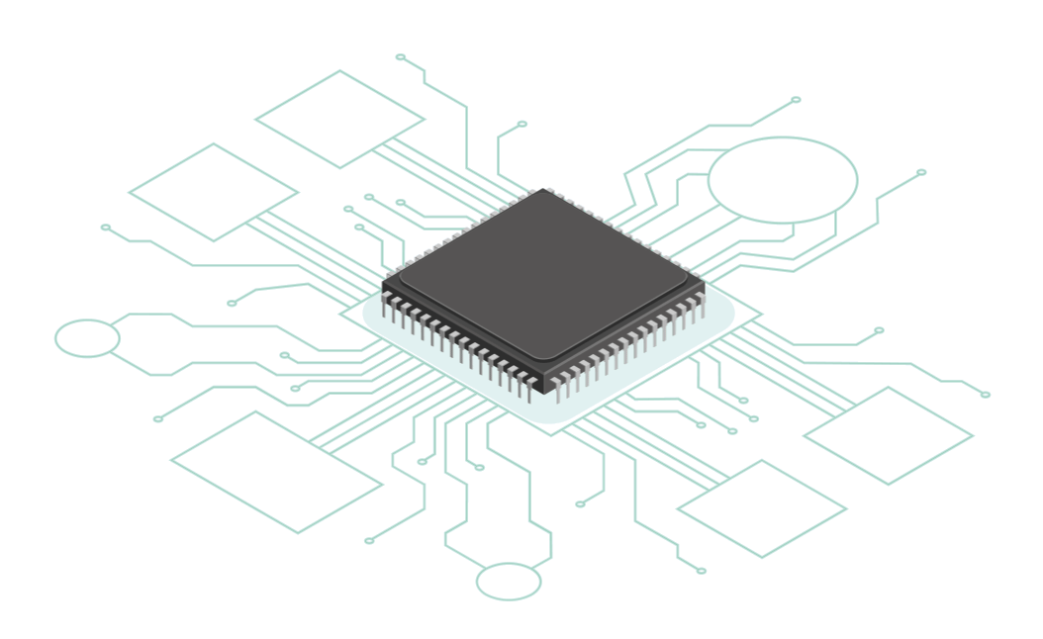
8085 Architecture/Block Diagram

Slide 51
INTA
RST6.5
TRAP
INTR
RST5.5
RST7.5
SID
SOD
Interrupt Control
Serial I/O Control
8-Bit Internal Data Bus
Accumulator (8)
Temp. Reg. (8)
Instruction Reg. (8)
Multiplexer
W (8)
Temp. Reg.
Z (8)
Temp. Reg.
Instruction Decoder and Machine Cycle Encoding
B (8)
Reg.
C (8)
Reg.
8085 Block Diagram
Flag (5) Flip-Flops
D (8)
Reg.
E (8)
Reg.
Register Select
H (8)
Reg.
L (8)
Reg.
Arithmetic Logic Unit (ALU) (8)
Stack Pointer (16)
Power Supply
+5 V
Program Counter (16)
GND
Increment/Decrement Address Latch (16)
X₁
Timing and Control
CLK GEN
X₂
Reset
Control
Status
DMA
Address Buffer (8)
Data/Address Buffer (8)
CLK OUT
RD
WR
S₀
S₁
IO/M
HLDA
RESET OUT
ALE
A₁₅ - A₈ Address Bus
AD₇ – AD₀ Address/Data Bus
READY
HOLD
RESET IN

Slide 52
INTA
RST6.5
TRAP
Used to hold data (i.e. temporary data) during ALU operation.
SID
SOD
RST7.5
Used to store 8-bit data to perform arithmetic & logical operations.
Result of operation is stored in Accumulator.
INTR
RST5.5
Interrupt Control
Serial I/O Control
8-Bit Internal Data Bus
Accumulator (8)
Temp. Reg. (8)
Instruction Reg. (8)
When Instruction is fetched from memory, it is loaded in the Instruction Registor (IR).
Multiplexer
W (8)
Temp. Reg.
Z (8)
Temp. Reg.
Instruction Decoder and Machine Cycle Encoding
B (8)
Reg.
C (8)
Reg.
S | Z |  | AC |  | P |  | CY
Flag (5) Flip-Flops
Instruction decoder decodes the information present in the Instruction register.
D (8)
Reg.
E (8)
Reg.
Register Select
H (8)
Reg.
L (8)
Reg.
Arithmetic Logic Unit (ALU) (8)
Stack Pointer (16)
Program Counter (16)
Increment/Decrement Address Latch (16)
X₁
Timing and Control
CLK GEN
Performs Computing Functions.
Accumulator, Temporary Register and Flag Registers are part of ALU.
Reset
Control
Status
DMA
Address Buffer (8)
Data/Address Buffer (8)
CLK OUT
RD
WR
S₀
S₁
HLDA
RESET OUT
ALE
A₁₅ - A₈ Address Bus
AD₇ – AD₀ Address/Data Bus
READY
HOLD
RESET IN

Slide 53
INTA
RST6.5
TRAP
INTR
RST5.5
RST7.5
SID
SOD
A multiplexer pulls out the right group of bits, depending on the instruction.
Interrupt Control
Serial I/O Control
8-Bit Internal Data Bus
Accumulator (8)
Temp. Reg. (8)
Instruction Reg. (8)
Multiplexer
Two additional 8-bit register, which holds the temporary data during execution of some instructions.
They are used internally, so they are not available to the programmer.
Each register can hold 8-bit data.
These registers can work in pair to hold 16-bit data and their pairing combination is like B-C, D-E & H-L.
W (8)
Temp. Reg.
Z (8)
Temp. Reg.
Instruction Decoder and Machine Cycle Encoding
B (8)
Reg.
C (8)
Reg.
Flag (5) Flip-Flops
D (8)
Reg.
E (8)
Reg.
Register Select
It increments the program counter as instructions execute, increments and decrements the stack pointer as needed, and supports the 16-bit increment and decrement instructions.
H (8)
Reg.
L (8)
Reg.
Arithmetic Logic Unit (ALU) (8)
Stack Pointer (16)
It is a 16-bit register works like stack, which is always incremented/decremented by 2 during push & pop operations.
16-bit register used to store the memory address location of the next instruction to be executed.
Program Counter (16)
Increment/Decrement Address Latch (16)
The content stored in the SP and PC is loaded into the Address Buffer and Data/Address Buffer.
The memory and I/O chips are connected to these buses that can exchange the data.
X₁
Timing and Control
CLK GEN
Reset
Control
Status
DMA
Address Buffer (8)
Data/Address Buffer (8)
CLK OUT
RD
WR
S₀
S₁
HLDA
RESET OUT
ALE
A₁₅ - A₈ Address Bus
AD₇ – AD₀ Address/Data Bus
READY
HOLD
RESET IN

Slide 54
INTA
RST6.5
TRAP
INTR
RST5.5
RST7.5
SID
SOD
Interrupt Control
Serial I/O Control
8-Bit Internal Data Bus
Accumulator (8)
Temp. Reg. (8)
Instruction Reg. (8)
Multiplexer
W (8)
Temp. Reg.
Z (8)
Temp. Reg.
Instruction Decoder and Machine Cycle Encoding
B (8)
Reg.
C (8)
Reg.
Flag (5) Flip-Flops
D (8)
Reg.
E (8)
Reg.
Register Select
H (8)
Reg.
L (8)
Reg.
This unit synchronizes all the microprocessor operations with the clock and generates control signal necessary for communication between microprocessor & peripheral.
Arithmetic Logic Unit (ALU) (8)
Stack Pointer (16)
Read/write either to/from memory or peripherals.
Program Counter (16)
Perform synchronization with peripheral device.
Address Latch Enable control signal
Input signal to synchronize microprocessor with peripheral device.
Frequency Control Signals
DMA control signal
Increment/Decrement Address Latch (16)
Shows read/write status to/from memory or I/O.
X₁
Timing and Control
Signal to RESET microprocessor and other devices connected to it.
CLK GEN
X₂
Reset
Control
Status
DMA
Address Buffer (8)
Data/Address Buffer (8)
CLK OUT
RD
WR
S₀
S₁
HLDA
RESET OUT
ALE
A₁₅ - A₈ Address Bus
AD₇ – AD₀ Address/Data Bus
HOLD
RESET IN
READY

Slide 55
INTA
RST6.5
TRAP
INTR
RST5.5
RST7.5
SID
SOD
Interrupt Control
Serial I/O Control
8-Bit Internal Data Bus
Accumulator (8)
Temp. Reg. (8)
Instruction Reg. (8)
Multiplexer
W (8)
Temp. Reg.
Z (8)
Temp. Reg.
Instruction Decoder and Machine Cycle Encoding
B (8)
Reg.
C (8)
Reg.
Flag (5) Flip-Flops
D (8)
Reg.
E (8)
Reg.
Register Select
H (8)
Reg.
L (8)
Reg.
Arithmetic Logic Unit (ALU) (8)
Stack Pointer (16)
Program Counter (16)
Increment/Decrement Address Latch (16)
X₁
Timing and Control
CLK GEN
X₂
Reset
Control
Status
DMA
Address Buffer (8)
Data/Address Buffer (8)
CLK OUT
RD
WR
S₀
S₁
HLDA
RESET OUT
ALE
A₁₅ - A₈ Address Bus
AD₇ – AD₀ Address/Data Bus
HOLD
RESET IN
READY

Slide 56
INTA
RST6.5
TRAP
INTR
RST5.5
RST7.5
SID
SOD
Interrupt Control
Serial I/O Control
8-Bit Internal Data Bus
%
It controls the serial data communication by using two instructions:
SID (Serial input data)
SOD (Serial output data)
Accumulator (8)
Temp. Reg. (8)
Instruction Reg. (8)
Multiplexer
It controls the interrupts during a process.
There are 5 interrupt signals in 8085 microprocessor:
TRAP, RST 7.5, RST 6.5, RST 5.5, INTR.
W (8)
Temp. Reg.
Z (8)
Temp. Reg.
Instruction Decoder and Machine Cycle Encoding
B (8)
Reg.
C (8)
Reg.
Flag (5) Flip-Flops
D (8)
Reg.
E (8)
Reg.
Register Select
H (8)
Reg.
L (8)
Reg.
Arithmetic Logic Unit (ALU) (8)
Stack Pointer (16)
Program Counter (16)
Increment/Decrement Address Latch (16)
X₁
Timing and Control
CLK GEN
X₂
Reset
Control
Status
DMA
Address Buffer (8)
Data/Address Buffer (8)
CLK OUT
RD
WR
S₀
S₁
HLDA
RESET OUT
ALE
A₁₅ - A₈ Address Bus
AD₇ – AD₀ Address/Data Bus
HOLD
RESET IN
READY

Slide 57
INTA
RST6.5
TRAP
INTR
RST5.5
RST7.5
SID
SOD
Interrupt Control
Serial I/O Control
8-Bit Internal Data Bus
Accumulator (8)
Temp. Reg. (8)
Instruction Reg. (8)
Multiplexer
W (8)
Temp. Reg.
Z (8)
Temp. Reg.
Instruction Decoder and Machine Cycle Encoding
B (8)
Reg.
C (8)
Reg.
Flag (5) Flip-Flops
D (8)
Reg.
E (8)
Reg.
Register Select
H (8)
Reg.
L (8)
Reg.
Arithmetic Logic Unit (ALU) (8)
Stack Pointer (16)
Power Supply
+5 V
Program Counter (16)
GND
Increment/Decrement Address Latch (16)
X₁
Timing and Control
CLK GEN
X₂
Reset
Control
Status
DMA
Address Buffer (8)
Data/Address Buffer (8)
CLK OUT
RD
WR
S₀
S₁
HLDA
RESET OUT
ALE
A₁₅ - A₈ Address Bus
AD₇ – AD₀ Address/Data Bus
READY
HOLD
RESET IN

Slide 58
GTU Exam Questions
Sr. | GTU Questions | Marks | Year
1. | Draw and explain the internal block diagram of 8085 microprocessor. | 7 | Sum-2019 Win-2018 Sum-2018

Slide 59
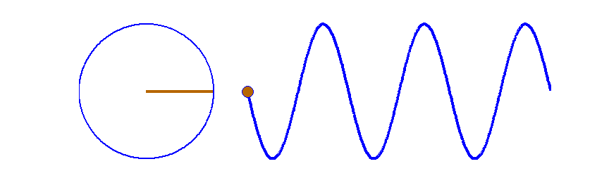
T-States, Machine and Instruction Cycle

Slide 60
T-States, Machine and Instruction Cycle
T-States
Operation performed in one clock period.
Machine Cycle
Time required by the microprocessor to complete an operation.
Instruction Cycle
Time required to complete execution of an instruction.

Slide 61

T-States
“T-States are defined as operation performed in one clock period.”
These sub-divisions are internal states synchronized with system clock & each T-state is precisely equal to one clock period.
 | T-State-1 | T-State-2 | T-State-3 | T-State-4
CLK
Clock Period

Slide 62

Machine Cycle
“Machine Cycle is defined as time required by the microprocessor to complete an operation.“
This cycle may consist 3 to 6 T-states.
The basic microprocessor operation such as reading a byte from I/O port or writing a byte to memory.
Fetch
m/m Read
IO write
Opcode Fetch
Memory Read
I/O Write
 | T1 | T2 | T3 | T4 | T1 | T2 | T3 | T1 | T2 | T3
CLK
Machine Cycle-1
Machine Cycle-2
Machine Cycle-3

Slide 63

Instruction Cycle
“Instruction Cycle is defined as time required to complete execution of an instruction.”
In 8085 microprocessor instruction cycle consists of 1 to 6 Machine Cycles or 1 to 6 operations.
 | T₁ | T₂ | T₃ | T₄
Instruction Cycle
CLK
Fetch Cycle
Execute Cycle

Slide 64
 | T-State-1 | T-State-2 | T-State-3 | T-State-4
T-States
CLK
Clock Period
Opcode Fetch
Memory Read
I/O Write
 | T1 | T2 | T3 | T4 | T1 | T2 | T3 | T1 | T2 | T3
Machine Cycle
CLK
Machine Cycle-1
Machine Cycle-2
Machine Cycle-3
 | T₁ | T₂ | T₃ | T₄
Instruction Cycle
Instruction Cycle
CLK
Fetch Cycle
Execute Cycle

Slide 65
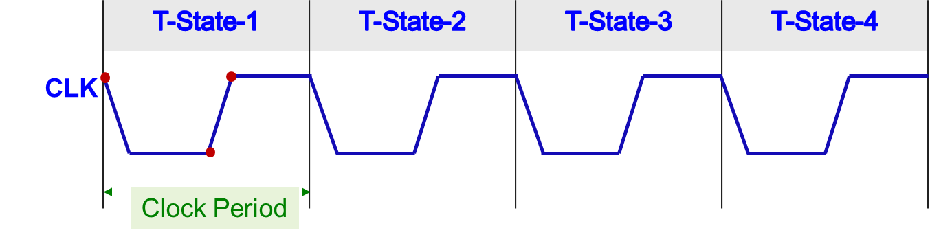
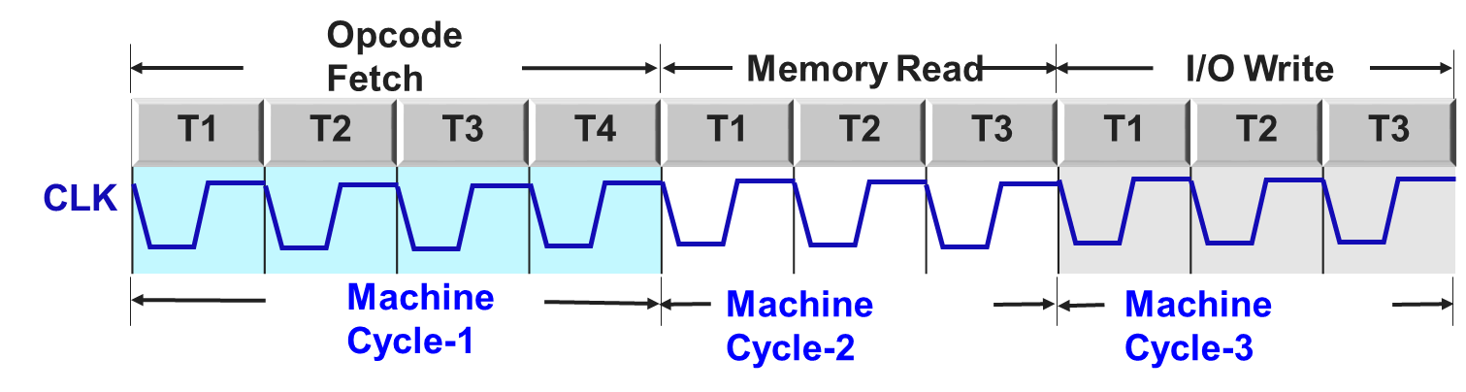
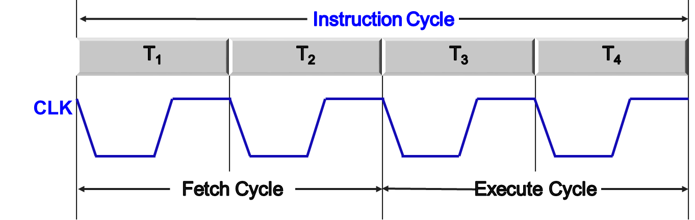
T-States
Machine Cycle
Instruction Cycle

Slide 66
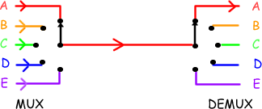
Demultiplexing Address and Data Bus AD₀-AD₇

Slide 67
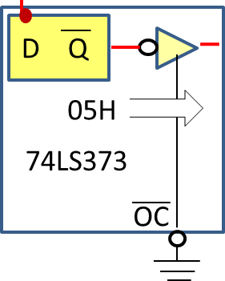
Demultiplexing AD₀-AD₇
A₁₅
0
A₁₅
0
A₁₄
1
A₁₃
0
A₁₂
High-Order Address Bus
0
A₁₁
0
A₁₀
0
A₉
A₈
0
A₈
8085 Microprocessor
ALE
Enable
G
ALE=1
Address Bus
AD₇
0
A₇
0
A₆
0
A₅
0
A₄
Low-Order Address Bus
1
A₃
0
A₂
1
A₁
AD₀
1
A₀
0
ALE= 0
Data Bus
1
D₇
0
D₆
0
D₅
Data Bus
1
D₄
1
D₃
1
D₂
1
D₁
D₀

Slide 68
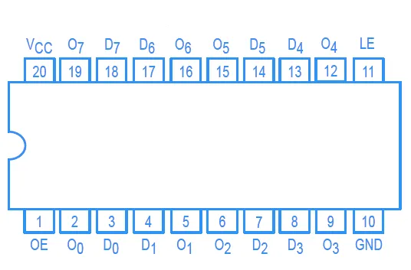
Demultiplexing AD₀-AD₇
The dual-purpose of the AD₀-AD₇ pins is achieved through multiplexing.
In simple words, multiplexing allows us to use the pins of a microprocessor for more than one function.
Advantage: Since each pin can serve multiple purposes, the total number of pins can be reduced.
IC 74LS373
IC 74LS373 is an IC with 20 pins.
it is a memory unit to hold one bit of data.
IC 74LS373

Slide 69
GTU Questions
Sr. | GTU Questions | Marks | Year
1. | How will the multiplexed address/data bus (AD₀-AD₇) of the 8085 microprocessor be demultiplexed? | 4 | Win-2017

Slide 70
Timing Diagram

Slide 71
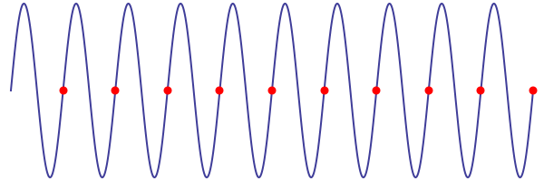
Timing Diagram

Slide 72
Opcode Fetch
 | T₁ | T₂ | T₃ | T₄
CLK
A₁₅
High order memory address
Unspecified
A₈
AD₇
Low order M/m addr.
Opcode
AD₀
Timing Diagram: Opcode Fetch
ALE
IO/M
RD

Slide 73
Memory read cycle
 | T₁ | T₂ | T₃ | T₄
CLK
A₁₅
High order memory address
A₈
AD₇
Timing Diagram: Memory Read Cycle
Low order M/m addr.
Data from memory
AD₀
S₁ | S₀ | Mode
0 | 0 | HLT
0 | 1 | WRITE
1 | 0 | READ
ALE
IO/M
S₀
IO/M=0, S₁=1 , S₀=0
S₁
RD

Slide 74
Memory write cycle
 | T₁ | T₂ | T₃ | T₄
CLK
A₁₅
High order memory address
A₈
AD₇
Timing Diagram: Memory Write Cycle
Low order M/m addr.
Data from Microprocessor
AD₀
S₁ | S₀ | Mode
0 | 0 | HLT
0 | 1 | WRITE
1 | 0 | READ
ALE
IO/M
S₁
IO/M=0, S₀=1 , S₁=0
S₀
WR

Slide 75
Memory Interfacing

Slide 76
Memory structure
Block diagram of Memory Device: RAM
N=Number of Register
M=Word Length
E.g.
If a memory is having
address lines=13
data lines=8
then
Number of memory locations = N=2¹³ = 8192
Word length M= 8 bit
Therefore, N X M= 8192 X 8
Data Inputs
Input Buffer
WR
CS
A₁₀
N X M
Memory
Address
Input
Internal Decoder
A₀
Output Buffer
RD
Data Output

Slide 77
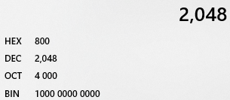
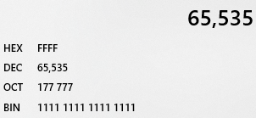
Memory structure
No. of Lines | Memory size(bytes)
No. of Lines | Memory size(bytes)
1 | 2
9 | 512
2 | 4
10 | 1024=1k
3 | 8
11 | 2048=2k
4 | 16
12 | 4096=4k
5 | 32
13 | 8192=8k
6 | 64
14 | 16384=16k
7 | 128
15 | 32768=32k
8 | 256
16 | 65536=64k

Slide 78
Memory Interfacing
8085 can access 64K of memory, thus address bus is of 16-bit.
It is not always necessary to use full 64K address space. The total memory size depends upon the application.
Generally EPROM is used as a program memory and RAM is used as data memory.
When both are used then total 64K address will be shared by both.
The capacity of program memory and data memory depends on the application.

Slide 79
Memory Interfacing
It is not always necessary to select 1 EPROM and 1 RAM. We can have multiple EPROMs and multiple RAMs as per the requirement of application.
We can place EPROM / RAM anywhere in full 64 Kbytes address space.
Program memory (EPROM) should be located from address 0000H, since reset address of 8085 microprocessor is 0000H.
It is not always necessary to locate EPROM and RAM in consecutive memory addresses.

Slide 80
Memory Interfacing: Example 1
Interface 4kB of EPROM with starting address from 0000H and 2kB of RAM with starting address followed by EPROM
Step-1: To calculate no. of EPROM and RAM chip required
Total EPROM required = 4kB
Chip size available = 4kB
No. of chips required = 4kB/4kB=1
Total RAM required = 2kB
Chip Size Available = 2kB
No. of Chips required = 2kB/2kB=1

Slide 81
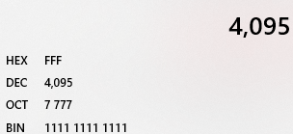
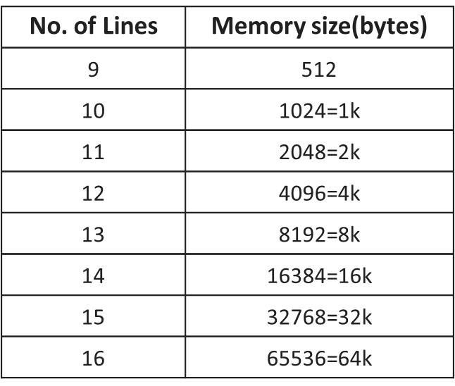
Memory Interfacing: Example 1
Step-2: To calculate starting and ending address of EPROM
EPROM Chip-1:
Starting Address = 0000H
Chip Size = 4kB (i.e. address Line=12, m/m = 2¹² = 4096B = 4k)
Ending Address = 0FFFH
Step-3: To calculate starting and ending address of RAM
RAM Chip-1:
Starting address = Ending address of EPROM +1
= 0FFFH+1
= 1000H
Chip Size = 2kB = 07FFH
Ending address = 1000H+07FFH
= 17FFH

Slide 82
Memory Interfacing: Example 1
Step-4: Memory Map | A ₁₅ | A ₁₄ | A ₁₃ | A ₁₂ | A ₁₁ | A ₁₀ | A ₉ | A ₈ | A ₇ | A ₆ | A ₅ | A ₄ | A ₃ | A ₂ | A ₁ | A ₀
EPROM 4k | Start Address 0000 H
 | End Address 0FFF H
0
0
0
0
0
0
0
0
0
0
0
0
0
0
0
0
0
0
0
0
1
1
1
1
1
1
1
1
1
1
1
1
RAM 2k | Start Address 1000 H
 | End Address 17FF H
0
0
0
1
0
0
0
0
0
0
0
0
0
0
0
0
0
0
0
1
0
1
1
1
1
1
1
1
1
1
1
1
EPROM chip size = 4kB & RAM chip size = 2kB
∴smaller chip size RAM = 2kB = 2¹¹
Thus neglect lower 11 address lines (A₀ to A₁₀), and consider A₁₁ to A₁₅ for Decoding.

Slide 83
Memory Interfacing: Example 1
 |  | A ₁₅ | A ₁₄ | A ₁₃ | A ₁₂ | A ₁₁ | A ₁₀ | A ₉ | A ₈ | A ₇ | A ₆ | A ₅ | A ₄ | A ₃ | A ₂ | A ₁ | A ₀
EPROM | Start Address 0000 H
 | End Address 0FFF H
0
0
0
0
0
0
0
0
0
0
0
0
0
0
0
0
0
0
0
0
1
1
1
1
1
1
1
1
1
1
1
1
EPROM
Required Address Lines: A₁₁ to A_{15.}
Now, EPROM has two Possibilities, either 00000 b or 00001 b.
Therefore, it requires Y₀ and Y₁ outputs of decoder.

Slide 84
Memory Interfacing: Example 1
 |  | A ₁₅ | A ₁₄ | A ₁₃ | A ₁₂ | A ₁₁ | A ₁₀ | A ₉ | A ₈ | A ₇ | A ₆ | A ₅ | A ₄ | A ₃ | A ₂ | A ₁ | A ₀
EPROM | Start Address 0000 H
 | End Address 0FFF H
0
0
0
0
0
0
0
0
0
0
0
0
0
0
0
0
0
0
0
0
1
1
1
1
1
1
1
1
1
1
1
1
RAM | Start Address 1000 H
 | End Address 17FF H
0
0
0
1
0
0
0
0
0
0
0
0
0
0
0
0
0
0
0
1
0
1
1
1
1
1
1
1
1
1
1
1
RAM has 00010 b, hence it requires Y₂ output of decoder.

Slide 85
Memory Interfacing: Example 1 Implementation
Step-5:
RD
IO/M
A₀ - A₁₀
WR
EPROM
OE
RD
D₀
-
D₇
Y₀
00000
5:32
Decoder
To EPROM
A₁₅
Y₁
00001
A₁₄
Y₂
To RAM
A₀ - A₁₀
D₀ – D₇
A₁₃
00010
RAM
A₁₂
OE
A₁₁

Slide 86
Memory Interfacing: Example 2
Interface 16kB of EPROM with chip size of 8kB and starting address from 0000H and 8kB of RAM with starting address followed by EPROM.
Step-1: To calculate no. of EPROM and RAM chip required
Total EPROM required =16kB
Chip size available = 8kB
No. of chips required = 16kB/8kB = 2
Total RAM required = 8kB
Chip size available = 8kB
No. of chips required = 8kB/8kB = 1

Slide 87
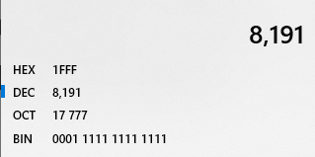
Memory Interfacing: Example 2
Step-2: To calculate starting and ending address of EPROM
EPROM Chip-1:
Starting Address = 0000H
Chip Size = 8kB (i.e. address Line=13, m/m=2¹³ =8192B =8k)
Ending Address = 1FFFH
EPROM Chip-2:
Starting Address =1FFFH + 1 = 2000H
Chip Size = 1FFFH
Ending Address = 2000+1FFFH = 3FFFH

Slide 88
Memory Interfacing: Example 2
Step-3: RAM Chip-1:
Starting Address = EPROM ending address + 1
Starting Address = 3FFFH+1 = 4000H
Chip Size = 8kB (i.e. address Line =13, m/m=2¹³ = 8192B =8k)
Chip Size = 1FFFH
Ending Address = 4000h+1FFFH = 5FFFH

Slide 89
Memory Interfacing: Example 2
Step-4: Memory Map | A ₁₅ | A ₁₄ | A ₁₃ | A ₁₂ | A ₁₁ | A ₁₀ | A ₉ | A ₈ | A ₇ | A ₆ | A ₅ | A ₄ | A ₃ | A ₂ | A ₁ | A ₀
EPROM1 | Start Address 0000 H
 | End Address 1FFF H
0
0
0
0
0
0
0
0
0
0
0
0
0
0
0
0
0
0
0
1
1
1
1
1
1
1
1
1
1
1
1
1
EPROM2 | Start Address 2000 H
 | End Address 3FFF H
0
0
1
0
0
0
0
0
0
0
0
0
0
0
0
0
0
0
1
1
1
1
1
1
1
1
1
1
1
1
1
1
RAM | Start Address 4000 H
 | End Address 5FFF H
0
1
0
0
0
0
0
0
0
0
0
0
0
0
0
0
0
1
0
1
1
1
1
1
1
1
1
1
1
1
1
1

Slide 90
Memory Interfacing: Example 2
Step-5:Interface Implementation
EPROM chip size = RAM chip size = 8kB = 2¹³
Therefore, neglect lower 13 address lines (i.e. A₀ to A₁₂) and consider only A₁₃ to A₁₅ for decoding.
EPROM CHIP-01 | 000
EPROM CHIP-02 | 001
RAM CHIP-01 | 010
Y₀
To EPROM Chip-1
3:8
Decoder
Y₁
To EPROM Chip-2
A₁₅
Y₂
To RAM Chip-1
A₁₄
A₁₃
Y₇

Slide 91
Memory Interfacing: Example 2
Step-4: Memory Map | A ₁₅ | A ₁₄ | A ₁₃ | A ₁₂ | A ₁₁ | A ₁₀ | A ₉ | A ₈ | A ₇ | A ₆ | A ₅ | A ₄ | A ₃ | A ₂ | A ₁ | A ₀
EPROM1 | Start Address 0000 H
 | End Address 1FFF H
0
0
0
0
0
0
0
0
0
0
0
0
0
0
0
0
0
0
0
1
1
1
1
1
1
1
1
1
1
1
1
1
EPROM2 | Start Address 2000 H
 | End Address 3FFF H
0
0
1
0
0
0
0
0
0
0
0
0
0
0
0
0
0
0
1
1
1
1
1
1
1
1
1
1
1
1
1
1
RAM | Start Address 4000 H
 | End Address 5FFF H
0
1
0
0
0
0
0
0
0
0
0
0
0
0
0
0
0
1
0
1
1
1
1
1
1
1
1
1
1
1
1
1

Slide 92
Memory Interfacing: Example 2 Implementation
Step-5:
RD
A₀ - A₁₂
EPROM
CHIP-1
IO/M
OE
WR
D₀
-
D₇
RD
D₀ – D₇
A₀ - A₁₂
EPROM
CHIP-2
Y₀
000
To EPROM CHIP-1
OE
3:8
Decoder
Y₁
001
To EPROM CHIP-2
A₁₅
010
Y₂
To RAM
A₁₄
A₁₃
RAM
D₀ – D₇
A₀ - A₁₂
OE

Slide 93
Exercise: Memory Interface Example
Draw the interfacing of a 4KB EPROM having a starting address 2000h and two 2KB static RAMs having starting addresses 4000h and 8000h, respectively, with 8085 microprocessor.
Design an 8085 microprocessor system such that it should contain 16KB of EPROM and 4KB of RAM with starting addresses 0000H and 4000H respectively. Use two 8KB of EPROMs (2764) and two 2KB of RAMs (6116) for this system.

Slide 94
Exercise: Example 1
Step-4: Memory Map | A ₁₅ | A ₁₄ | A ₁₃ | A ₁₂ | A ₁₁ | A ₁₀ | A ₉ | A ₈ | A ₇ | A ₆ | A ₅ | A ₄ | A ₃ | A ₂ | A ₁ | A ₀
EPROM1 | Start Address 2000 H
 | End Address 2FFF H
0
0
1
0
0
0
0
0
0
0
0
0
0
0
0
0
0
0
1
0
1
1
1
1
1
1
1
1
1
1
1
1
RAM 1 | Start Address 4000 H
 | End Address 47FF H
0
1
0
0
0
0
0
0
0
0
0
0
0
0
0
0
0
1
0
0
0
1
1
1
1
1
1
1
1
1
1
1
RAM 2 | Start Address 8000 H
 | End Address 87FF H
1
0
0
0
0
0
0
0
0
0
0
0
0
0
0
0
1
0
0
0
0
1
1
1
1
1
1
1
1
1
1
1

Slide 95
Exercise: Example 1
Step-5:
RD
A₀ - A₁₂
EPROM
CHIP
IO/M
OE
WR
D₀
-
D₇
RD
D₀ – D₇
A₀ - A₁₂
RAM-1
Y₀
00100
OE
5:32
Decoder
To EPROM
Y₁
00101
A₁₅
Y₂
A₁₄
To RAM-1
01000
A₁₃
Y₃
A₁₂
To RAM-2
10000
RAM-2
A₁₁
D₀ – D₇
A₀ - A₁₂
OE

Slide 96
Exercise: Example 2
Step-4: Memory Map | A ₁₅ | A ₁₄ | A ₁₃ | A ₁₂ | A ₁₁ | A ₁₀ | A ₉ | A ₈ | A ₇ | A ₆ | A ₅ | A ₄ | A ₃ | A ₂ | A ₁ | A ₀
EPROM1 | Start Address 0000 H
 | End Address 1FFF H
0
0
0
0
0
0
0
0
0
0
0
0
0
0
0
0
0
0
0
1
1
1
1
1
1
1
1
1
1
1
1
1
EPROM2 | Start Address 2000 H
 | End Address 3FFF H
0
0
1
0
0
0
0
0
0
0
0
0
0
0
0
0
0
0
1
1
1
1
1
1
1
1
1
1
1
1
1
1
RAM 1 | Start Address 4000 H
 | End Address 47FF H
0
1
0
0
0
0
0
0
0
0
0
0
0
0
0
0
0
1
0
0
0
1
1
1
1
1
1
1
1
1
1
1
RAM 2 | Start Address 4800 H
 | End Address 4FFF H
0
1
0
0
1
0
0
0
0
0
0
0
0
0
0
0
0
1
0
0
1
1
1
1
1
1
1
1
1
1
1
1

Slide 97
Exercise: Example 2
Step-5:
A₀ - A₁₀
RD
EPROM-1
OE
IO/M
D₀
-
D₇
WR
RD
A₀ - A₁₀
EPROM-2
OE
D₀
-
D₇
Y₀
00011
5:32
Decoder
00100
EPROM-1
Y₁
D₀ – D₇
A₀ - A₁₀
RAM-1
A₁₅
OE
A₁₄
00101
EPROM-2
Y₂
A₁₃
A₁₂
Y₃
01000
To RAM-1
A₁₁
RAM-2
Y₄
10000
To RAM-2
D₀ – D₇
A₀ - A₁₀
OE

Slide 98

Generating Control Signals

Slide 99

Generating Control Signals
I0/M | RD | WR | Operation
0 | 0 | 0 | Invalid
0 | 0 | 1 | MEMR
IO/M
0
MEMR
0
RD
8085
WR
1

Slide 100
Generating Control Signals
I0/M | RD | WR | Operation
0 | 0 | 0 | Invalid
MEMR
0 | 0 | 1
0 | 1 | 0
MEMW
0
IO/M
MEMR
MEMR
RD
1
8085
WR
0
MEMW

Slide 101
Generating Control Signals
I0/M | RD | WR | Operation
0 | 0 | 0 | Invalid
MEMR
0 | 0 | 1
0 | 1 | 0
MEMW
0 | 1 | 1 | NOP
IO/M
0
MEMR
RD
1
8085
1
MEMW
WR

Slide 102
Generating Control Signals
I0/M | RD | WR | Operation
MEMR
0 | 0 | 1
0 | 1 | 0
MEMW
0 | 1 | 1 | NOP
1 | 0 | 0 | Invalid
IO/M
1
MEMR
RD
0
8085
WR
0
MEMW

Slide 103
Generating Control Signals
I0/M | RD | WR | Operation
MEMR
0 | 0 | 1
0 | 1 | 0
MEMW
0 | 1 | 1 | NOP
1 | 0 | 1
IOR
IO/M
1
MEMR
RD
0
8085
WR
1
MEMW
IOR

Slide 104
Generating Control Signals
I0/M | RD | WR | Operation
MEMR
0 | 0 | 1
0 | 1 | 0
MEMW
0 | 1 | 1 | NOP
1 | 0 | 1
IOR
1 | 1 | 0
IOW
IO/M
1
MEMR
RD
1
8085
WR
0
MEMW
IOR
IOW

Slide 105
Generating Control Signals
I0/M | RD | WR | Operation
MEMR
0 | 0 | 1
0 | 1 | 0
MEMW
0 | 1 | 1 | NOP
1 | 0 | 1
IOR
1 | 1 | 0
IOW
1 | 1 | 1 | NOP
IO/M
1
MEMR
RD
1
8085
WR
1
MEMW
IOR
IOW

Slide 106
Generating Control Signals
I0/M | RD | WR | Operation
0 | 0 | 0 | HLT
MEMR
0 | 0 | 1
0 | 1 | 0
MEMW
0 | 1 | 1 | NOP
1 | 0 | 0 | HLT
1 | 0 | 1
IOR
1 | 1 | 0
IOW
1 | 1 | 1 | NOP

Slide 107
GTU Exam Questions
Sr. | GTU Questions
1. | How will the multiplexed address/data bus (AD0-AD7) of the 8085 microprocessor be demultiplexed?
2. | Explain the flag register of the 8085 microprocessor with examples.
3. | Draw the interfacing of a 4KB EPROM having a starting address 2000h and two 2KB static RAMs having starting addresses 4000h and 8000h, respectively, with 8085 microprocessor. Use demultiplexed address/data lines and use 3-to-8 decoder (74LS138).
4. | Draw and explain the internal block diagram of 8085 microprocessor.
5. | List the sequence of events that occurs when the 8085 MPU reads from memory.
6. | Explain 8085 Programming Model and Flag Register.
7. | Discuss the programming model of 8085 μP with the help of suitable diagram.
8. | Draw and Explain the pin diagram of 8085 microprocessor.

Slide 108

References
Book: | Microprocessor Architecture, Programming, and Applications with the 8085, Ramesh S. Gaonkar Pub: Penram International

Slide 109
Thank You

